Slide 1
A four-VSC benchmark system : grid data and operating points
Thierry Van Cutsem
thierry.h.van.cutsem@gmail.com
https://thierryvancutsem.github.io/home/
March 28, 2024

Slide 2
Motivation and objectives
Power-electronics converters push the phasor approximation to its limit (and beyond…)
There is a need for benchmark systems
with large penetration of converters
small enough to be easily tractable
complex enough to reflect real-life systems
easily implemented in various simulation tools
A 100% power electronics, 4-VSC test system is presented
Models and data are available in open source

Slide 3
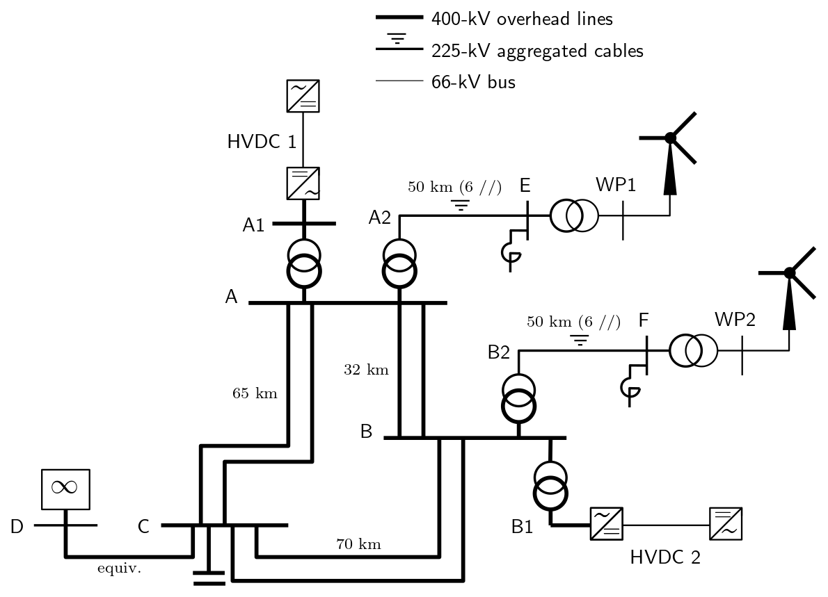
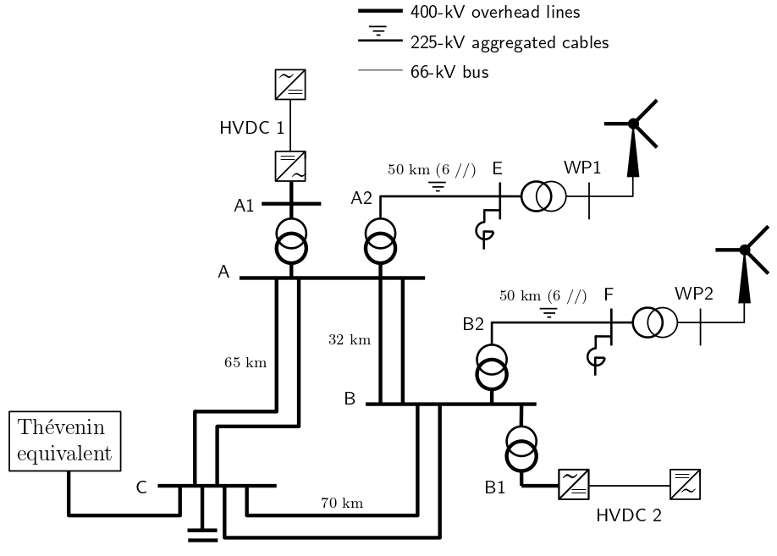
Topology and main characteristics

Slide 4
Network parameters
line / cable | nominal voltage | R (Ω) | X (Ω) | ωC/2 (μS) | length (km) | Snom (MVA)
A-C * | 400 | 1.04 | 20.80 | 98 | 65 | 3000
A-B * | 400 | 0.51 | 10.24 | 48 | 32 | 3000
B-C * | 400 | 1.12 | 22.40 | 105 | 70 | 3000
A2-E ** | 225 | 0.42 | 0.83 | 9000 | 50 km | 2400
B2-F ** | 225 | 0.42 | 0.83 | 9000 | 50 km | 2400
* data of a single circuit
** data of 6 cables in parallel (400 MVA each)

Slide 5
transformer | nominal voltages | R (%) | X (%) | transfo ratio (%) | Snom (MVA)
A1-A | 320 / 400 | 0.5 | 15.0 | 102. | 1200
B1-B | 320 / 400 | 0.5 | 15.0 | 104. | 1700
A2-A | 225 / 400 | 0.5 | 15.0 | 102. | 2400
B2-B | 225 / 400 | 0.5 | 15.0 | 105. | 2400
WP1-E * | 66 / 225 | 0.5 | 12.0 | 105. | 2400
WP2-F * | 66 / 225 | 0.5 | 12.0 | 104. | 2400
* 6 transformers in parallel,
400 MVA each
converter | Snom (MVA) | Pnom (MW)
WP1 | 2400 | 2300
WP2 | 2400 | 2300
HVDC1 | 1200 | 1150
HVDC2 | 1700 | 1630

Slide 6
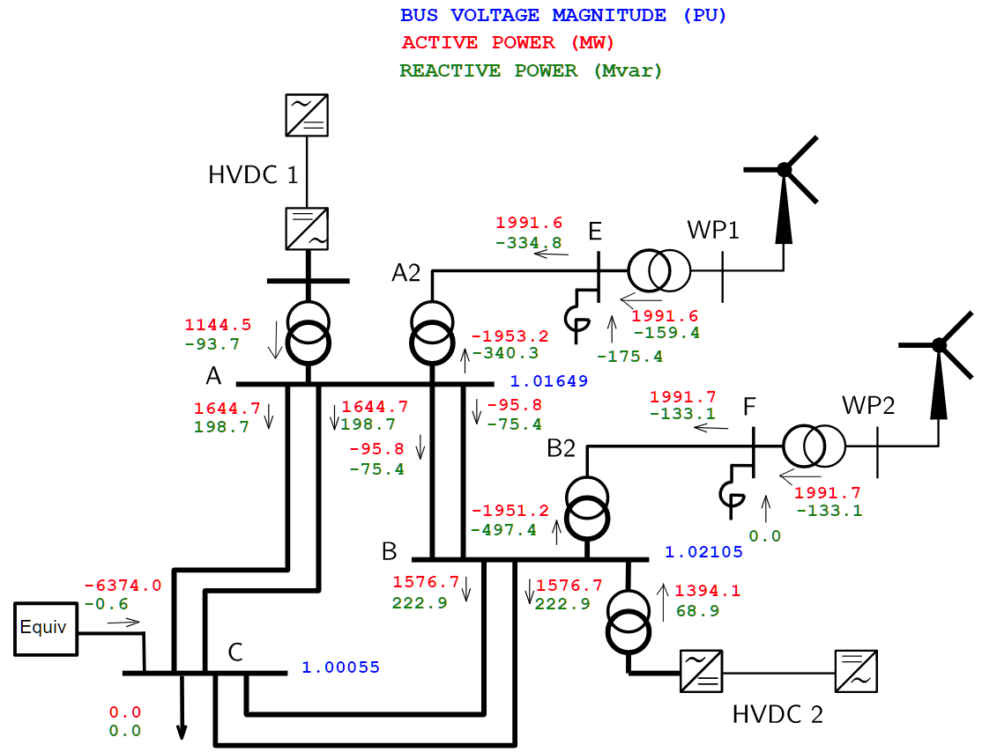
Operating point No. 1
Power injected by WPs and HVDC links exported to external system
network heavily loaded
no load

Slide 7
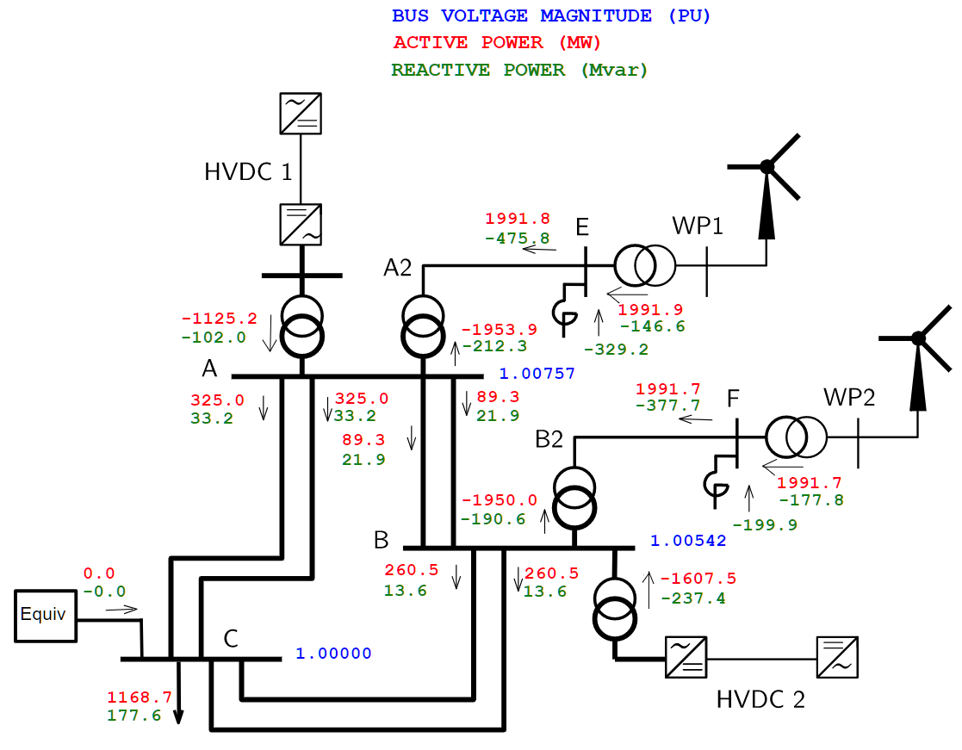
Operating point No. 2
WP productions exported by HVDC links
load at bus C
zero power flow in external equivalent
network lightly loaded
larger shunt inductors

Slide 8
Thank you for our attention !
thierry.h.van.cutsem@gmail.com

